Slide 1


Slide 2
Budget 2022/23
Presenter : Henri Pieters
Wessel Smit

Slide 3
Budget 2022:
Budget Tax Proposals and Other Tax
Budget 2021
Summary Tax Proposals
Salary earners and individuals
Small business corporations
Capital gains tax
Companies
Trusts
Value Added Tax
Transfer Duty
Environmental Taxes
Fuel Levy
Unemployment Insurance Fund Contributions
Proposed Amendments

Slide 4
Scope of the seminar
Please note that this presentation deals with the February 2022 Budget speech proposals which have not yet been drafted into the tax legislation.
The final amendment act might differ from the proposals.

Slide 5
Budget 2022/23

Slide 6
Where the money comes from

Slide 7
How it will be spend

Slide 8
Summary Tax Proposals

Slide 9
Budget Highlights 2022/2023
Tax revenue strengthened significantly in recent months and is expected to reach R1.55 trillion for 2021/22, well above projections.
Given the revenue improvement, government proposes R5.2 billion in tax relief to help support the economic recovery, provide some respite from fuel tax increases and boost incentives for youth employment.
Most of the relief is provided through an adjustment in personal income tax brackets and rebates.
In addition, there will be no increase in either the general fuel levy or the Road Accident Fund levy.
Progress continues to be made in rebuilding the South African Revenue Service.

Slide 10
Salary earners and individuals

Slide 11
Tax of Individuals
The 2021 Budget provides tax relief by announcing an increase of 4,5 per cent in personal income tax brackets and rebates (inflation estimate at 4,5%)
The amount an individual can earn before being required to pay tax is adjusted as follows for the tax year from 1 March 2021 to 28 February 2022:

Slide 12
Tax Tables - Individuals
2022/2023 |  | 2022/2021
Taxable Income (R) | Rate of Tax (R) | Taxable Income (R) | Rate of Tax (R)
0 to 226 200 | 18% | 0 to 216 200 | 18%
226 201 to 353 100 | 40 680 + 26% | 216 201 to 337 800 | 38 916 + 26%
353 100 to 488 700 | 73 726 + 31% | 337 801 to 467 500 | 70 532 + 31%
488 700 to 641 400 | 115 762 + 36% | 467 501 to 613 600 | 110 739 + 36%
641 401 to 817 600 | 170 734 + 39% | 613 601 to 782 200 | 163 335 + 39%
817 601 to 1 731 600 | 239 452 + 41% | 782 201 to 1 656 600 | 229 089 + 41%
1 731 601 and above | 614 192 + 45% | 1 656 601 and above | 587 593 + 45%

Slide 13
Rebates
 | 2023 | 2022
Rebates for natural persons | (R) | (R)
Under 65 – Primary | 16 425 | 15 714
65 and over – Secondary | 9 000 | 8 613
75 and over - Tertiary | 2 997 | 2 871

Slide 14
Tax Thresholds
 | 2023 | 2022
 | (R) | (R)
Under 65 (primary) | 91 250 | 87 300
65 to 74 (secondary) | 141 250 | 135 150
75 and older (tertiary) | 157 900 | 151 100

Slide 15
Interest Exemption
 | 2023 | 2010
 | (R) | (R)
Under 65 | 23 800 | 23 800
Over 65 | 34 500 | 34 500
No future inflation adjustments –
Replaced by section 12T

Slide 16
Tax Free Investments
 | 2023 | 2022
 | (R) | (R)
Annual Limit | 36 000 | 36 000
Lifetime Limit | 500 000 | 500 000
Any amount received from a tax-free investment is exempt from normal tax (this includes normal income on the investment as well as any profit arising from the sale of the investment). The following requirements must be met:
The investment must be made by a natural person or the deceased or insured estate of a natural person
The investment must be a financial instrument or policy that is administered by a person or entity as designated by the Minister of Finance

Slide 17
Medical Tax Credits
 | 2023 | 2022
 | (R) | (R)
1st Dependent | 347 | 332
2nd Dependent | 347 | 332
Additional Dependents | 234 | 224

Slide 18
Subsistence Allowances
Travel in the Republic (2023 tax year)
  meals and incidental costs: R493 (2022: R452) per day
  incidental costs only: R152 (2022: R139) per day
Meals and incidental costs per day for a day trip: R 152 (2022: R 139)
Travel outside the Republic
  Various from country to country. Please refer to SARS website, www.sars.gov.za for latest rates.

Slide 19
Retirement Fund Lump Sum Withdrawal Benefits (unchanged)
Taxable income | Rate of tax
R | R
0 – 25 000 | 0% of taxable income
25 001 - 660 000 | 18% of taxable income above 25 000
660 001 - 990 000 | 114 300 + 27% of taxable income above 660 000
990 001 and above | 203 400 + 36% of taxable income above 990 000

Slide 20
Retirement Fund Lump Sum Benefits on Retirement or Severance (unchanged)
Taxable income | Rate of tax
R | R
0 – 500 000 | 0% of taxable income
500 001 – 700 000 | 18% of taxable income above 500 000
700 001 – 1 050 000 | 36 000 + 27% of taxable income above 700 000
1 050 001 and above | 130 500 + 36% of taxable income above 1 050 000

Slide 21
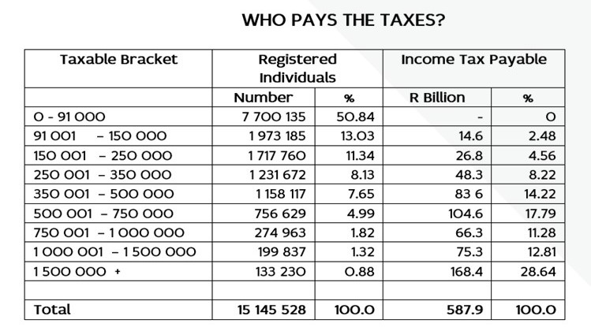


Slide 22
Small business corporations

Slide 23
Small Business Corporations
Taxable income | Rate of tax
R | R
0 – 91 250 | 0% of taxable income
91 251 – 365 000 | 7% of taxable income above 91 250
365 001 – 550 000 | 19 163 + 21% of taxable income above 365 000
550 001 and above | 58 013 + 28% of the amount above 550 000

Slide 24
Capital gains tax

Slide 25
Capital Gains Tax Exclusions
For Natural Persons
 | 2023 | 2022
 | (R) | (R)
Annual Exclusion | 40 000 | 40 000
Annual exclusion in year of death – gains and losses | 300 000 | 300 000
Disposal of small business by natural person if over age 55 | 1 800 000 | 1 800 000
Max market value of assets to qualify as a small business | 10mill | 10mill

Slide 26
Capital Gains Tax Exemptions
 | 2023 | 2022
 | (R) | (R)
Primary Residence Exclusion | 2,0 m | 2,0 m

Slide 27
Capital Gains Tax Effective Rates 2022/2023
Taxpayer | Inclusion Rate (%) | Statutory Rate (%) | Effective Rate (%)
Individuals | 40 | 0 – 45 | 0 – 18
Trusts
Special | 40 | 0 – 45 | 0 – 18
Other | 80 | 45 | 36
Companies
Ordinary | 80 | 28 | 22.4
Ordinary – YOA after 31 March 2023 | 80 | 27 | 21.6
Small business corporation | 80 | 0 – 28 | 0 – 22.4
Employment company (personal service provider) | 80 | 28 | 22.4
Foreign company (SA branch) | 80 | 28 | 22.4

Slide 28
Companies

Slide 29
Rates changed
Years of assessment ending on any date between 1 April 2022 and 30 March 2023 – 28%
Years of assessment ending on any date on or after 31 March 2023 – 27%
Dividend withholding tax rate remain at 20%

Slide 30
Trusts

Slide 31
Trusts
The tax rate on trusts are unchanged at 45%.

Slide 32
Value Added Tax

Slide 33
VAT
The vat rate are unchanged at 15%.

Slide 34
Transfer Duty

Slide 35
Transfer duty - Unchanged
Value of property (R) | Rate (R)
0 – R 1000 000 | 0% of property value
1 000 001 – 1 375 000 | 3% of property value above R 1 000 000
1 375 001 – 1 925 000 | 11 250 + 6% of property value above R 1 375 000
1 925 001 – 2 475 000 | 44 250 + 8% of property value above R 1 925 000
2 475 001 – 11 000 000 | 88 250 + 11% of property value above R 2 475 000
11 000 001 and above | 1 026 000 + 13% of property value above R 11 000 000

Slide 36
Environmental Taxes

Slide 37
Plastic bag levy
Plastic bag levy is increased by 3 cents to 28 cents per bag from 1 April 2022

Slide 38
Fuel Levy

Slide 39
Fuel Levy
No changes to the general fuel levy and road accident fund levy
This will increase:
  the general fuel levy will stay on R3.85 per litre of petrol and R3.70 per litre of diesel
  the road accident fund levy will still be R2.18 per litre for both petrol and diesel

Slide 40
Excise duties on alcohol and tobacco

Slide 41
Excise duties on alcohol and tobacco
Increases of between 4.5 and 6.5 per cent in excise duties on alcohol and tobacco.

