Slide 1
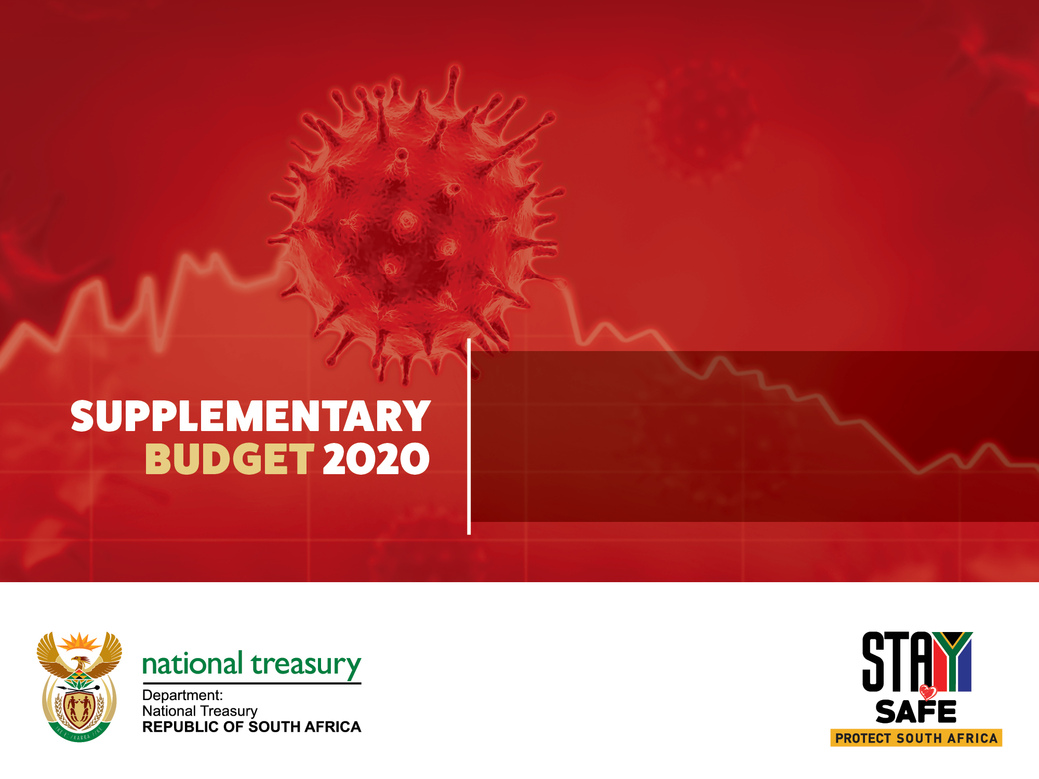
Building a bridge to recovery beyond covid-19

Slide 2
overview
This special adjustments budget has a dual purpose:
  It reports on the COVID-19 fiscal measures, and the resulting adjustments to the division of revenue and departmental allocations
  It also sets out government’s commitment to strengthen the public finances, and to position the economy for faster and inclusive growth
Government has responded to the COVID-19 pandemic with large-scale economic relief measures. Support is targeted at the most vulnerable South Africans. These steps will also build the capacity of the public health system to respond to the pandemic.
The National Treasury expects the economy to contract by 7.2 per cent in 2020. Households and firms are grappling with the combined effects of economic restrictions and the continued spread of the virus.
The public finances, which had reached an unsustainable position before the pandemic, are now dangerously overstretched. Without urgent action in the 2021 budget process, a debt crisis will follow.
This special adjustments budget is a bridge to the October 2020 Medium Term Budget Policy Statement. Over the next several months, government will prepare a set of far-reaching reforms. Determined implementation of these measures will stabilise public debt, contain the budget deficit, and fully restore economic activity to build confidence, increase investment and promote job creation.

Slide 3
Key points on economic interventions re: covid-19
Overall intervention is among the largest in the developing world
Monetary Policy:
  SARB cut interest rates by 250 bps – the median among emerging market countries is 100bps
  Liquidity programme helped lower the 10yr bond yield from a high of 12.4% to 9%
Fiscal Policy:
  Mildly expansionary before the pandemic
  Cyclically-adjusted primary balance in 2020/21 indicates South Africa’s fiscal stance is more expansionary than many peer EM countries
  The broad fiscal package amounts to more than 10% of GDP
Rebuilding Policy buffers
  Pre-crisis fiscal position: poor capacity to respond to crises. The fiscus is now dangerously unprepared for another shock nor supporting public investment
  Buffers can be rebuilt by immediately targeting a primary surplus in the next few years

Slide 4
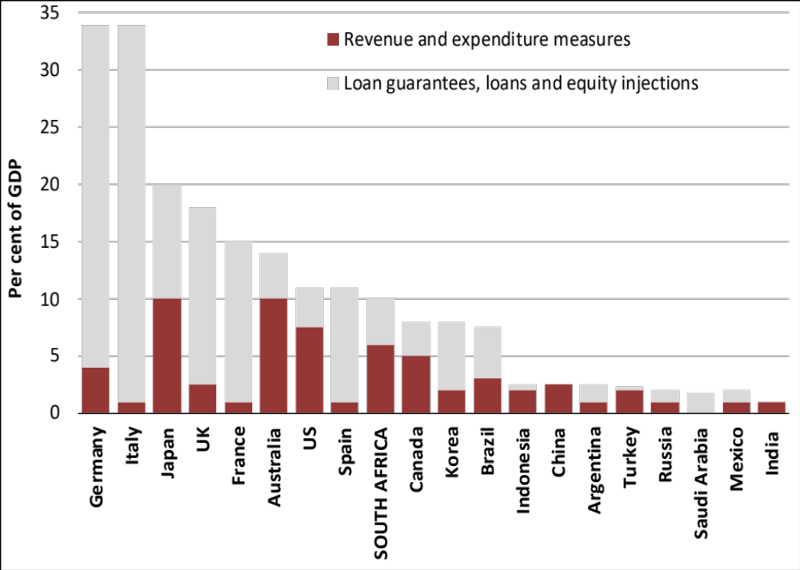
Announced fiscal package is larger than in other developing countries in the Group of 20
Comparison of economic support announced by G20 governments

Slide 5
THE ECONOMIC ENVIRONMENT HAS WORSENED SINCE BUDGET 2020
Global conditions have deteriorated significantly, with a global recession in 2020 now inevitable
  Risks around COVID-19 pandemic continue to play out, weighing on economic activity and sentiment
  High frequency activity data points to economic impact being far worse than the global financial crisis
Domestically, growth in Q4 2019 came out much worse than expected (at -1.4 per cent quarter-on-quarter seasonally adjusted annualised rate), bringing 2019 growth to 0.2 per cent
Growth was negatively affected by declines across the primary, secondary and tertiary sectors.
  Electricity constraints intensified in Q4 2019 and Q1 2020, weighing on production and sentiment even before COVID-19. Electricity production (distributed) fell to its lowest level in March 2020 since September 2003.
  High frequency data now showing a contraction in Q1 2020 is likely. March is expected to weigh strongly on the first quarter outcome as COVID-19 restrictions intensified both globally and domestically.
  Leading and sentiment indicators clearly point to significant declines in economic activity from April, and a slight recovery in activity in May – however indications are that demand remains very weak.
Inflationary pressure remains muted in the short term owing to weak domestic demand and lower oil prices
Risks to the global and domestic environment remain biased strongly to the downside
  Potential for further shut downs in response to infections
  Longer term ramifications for employment, investment and structure of trade
  Existing risks to trade tensions, dispersion heightened by pandemic

Slide 6
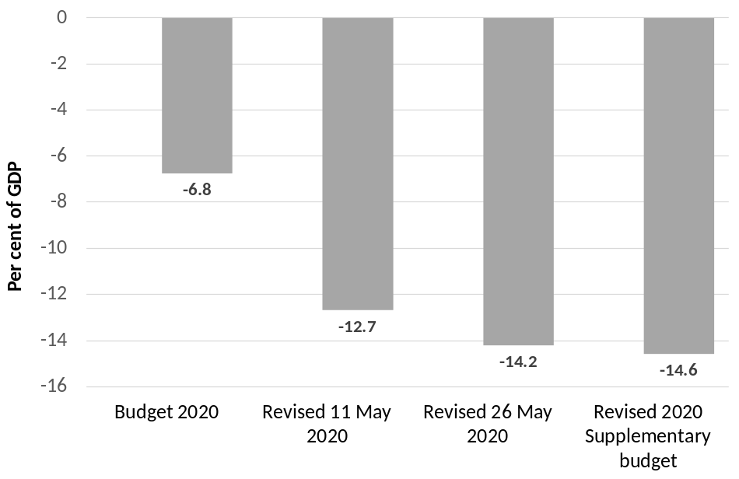
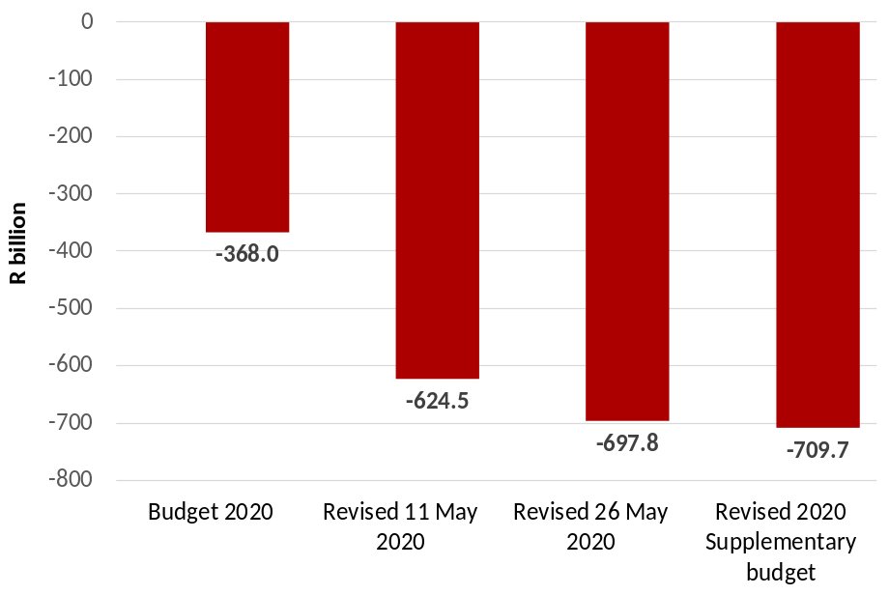
How has the fiscal situation changed since the 2020 Budget?
Main budget deficit (percent of GDP), 2020/21
Main budget deficit (R billion), 2020/21
The 2020/21 fiscal position, and the financing requirements, are markedly changed
The public finances, which had reached an unsustainable position before the pandemic, are now dangerously overstretched.
Without urgent action in the 2021 budget process, a debt crisis will follow.

Slide 7
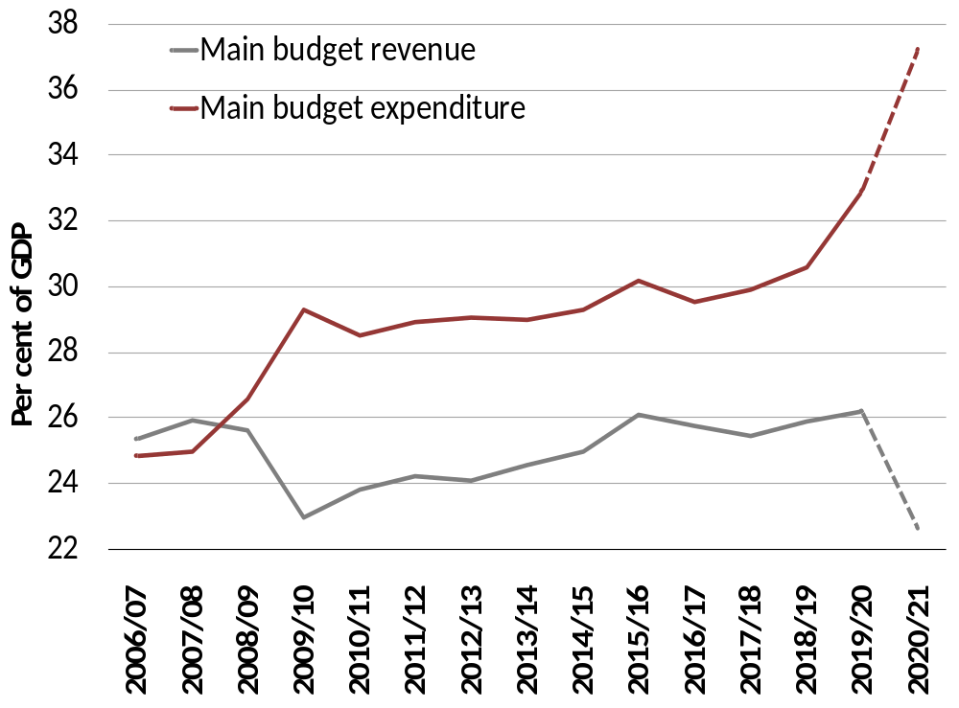
the gap between revenue and expenditure is expected to widen
Main budget revenue and expenditure
The COVID-19 pandemic erupted when South Africa was already in a weak fiscal position
In recent months, fiscal deterioration has accelerated
In 2020/21, significant tax revenue underperformance is expected, and expenditure will increase as government reprioritises and allocates funds to contain COVID-19.
The main budget deficit and gross borrowing requirement will increase sharply

Slide 8
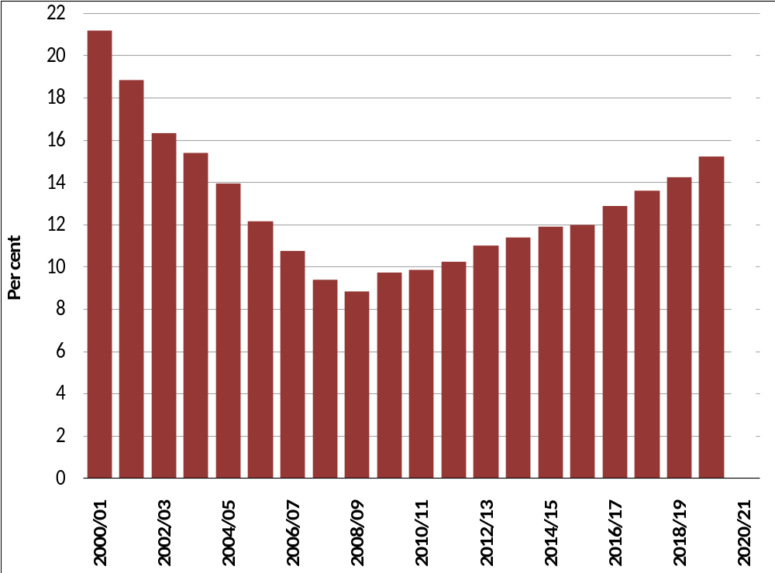
DEBT-SERVICE COSTS TAKE AN INCREASED share of MAIN BUDGET revenue
Debt-service costs as a proportion of main budget revenue
Gross national debt is now expected to reach 81.8 per cent of GDP in 2020/21 compared to the 2020 Budget estimate of 65.6 per cent of GDP
Rising public debt means that an ever-increasing share of tax revenue is transferred to bondholders

Slide 9
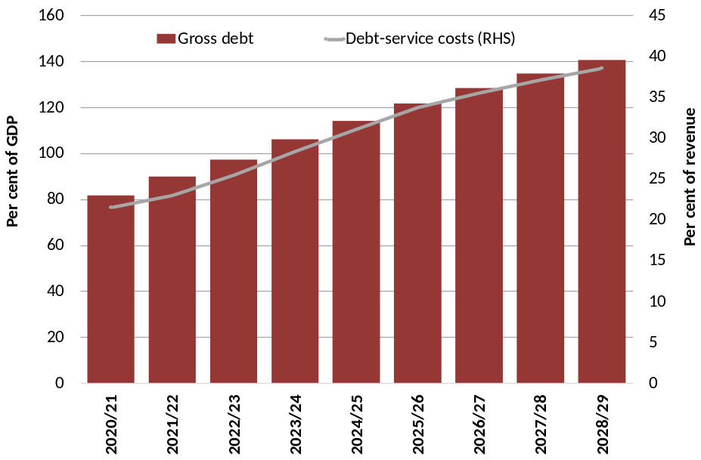
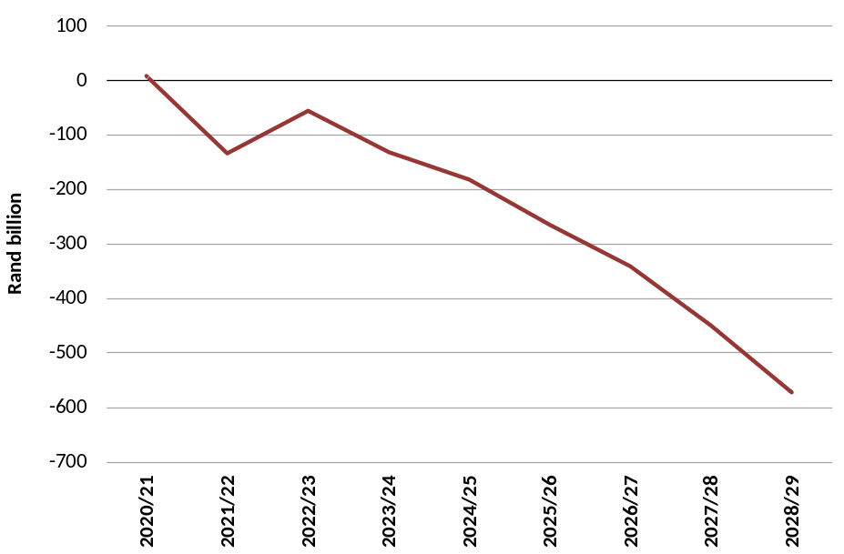
A DEBT crisis can have long run implications – CONSERVATIVE ANALYSIS
Debt dynamics
Loss of nominal GDP
Failure to arrest the debt trajectory will see debt-service costs consume around 31% of main budget revenue by 2024/25
The stock of debt crosses the 100% mark in 2023/24, reaching 140% in 2028/29
Deficits remain elevated at around 12% of GDP for a long-time, severely constraining domestic saving and investment
A fiscal crisis could deduct more than R2 trillion from GDP over the next decade

Slide 10
A phased approach to managing the pandemic
Government is responding to the pandemic in a phased manner:
      Phase 1 is to preserve the economy through a set of immediate, targeted and temporary responses.
      Phase 2 is a plan to recover from the immediate effects of the crisis by supporting investment and employment.
      Phase 3 is a pivot to position the economy for the faster growth needed to restore the country’s long-term prosperity.
    The COVID-19 fiscal package identifies R500 billion in economic relief.
      It includes R190 billion in main budget spending – of which R145 billion is allocated immediately – to protect lives and support livelihoods, R70 billion in tax policy measures and a R200 billion loan guarantee scheme to support short-term economic activity.
    The Reserve Bank has reduced interest rates and provided additional support to the bond market, financial-sector regulations have been eased to support the flow of credit to households and businesses, and commercial banks have introduced temporary payment holidays.
    To date, more than 18 million South Africans have received temporary COVID-19 grants, which – along with other interventions for vulnerable households – will cost about R41 billion

Slide 11
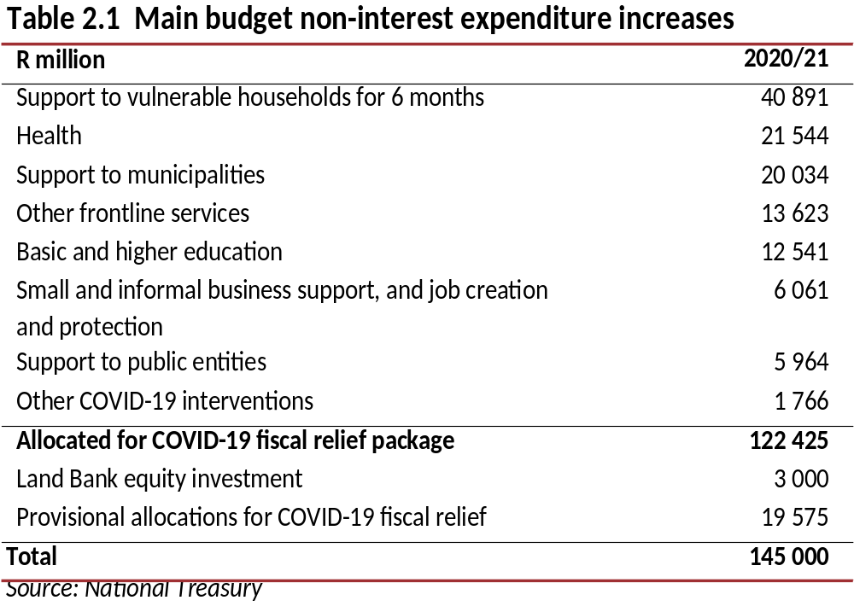
Additions to spending for the fiscal response to the pandemic
The COVID-19 fiscal relief measures are temporary and provide support where it is needed most.
Funding has been secured by shifting resources from existing programmes and drawing down surplus funds from institutions such as the Unemployment Insurance Fund
Government aims to spend these funds efficiently and effectively, avoiding waste.
Budget allocations across national, provincial and local government fund R145 billion of government’s response.

Slide 12
A phased approach to managing the pandemic (continued)
In its first few weeks of operation, the COVID-19 loan guarantee scheme had provided small businesses with over R10 billion worth of loans.
As of mid-June, the Unemployment Insurance Fund had provided R23 billion in COVID-19 relief to over 4.7 million workers.
To the greatest extent possible, the balance sheets and operational capacity of the broader public sector have been adjusted to form part of the national response.
  These include state-owned companies, the social security funds and public entities such as the National Health Laboratory Service and the South African Social Security Agency.
The National Treasury and the Reserve Bank have coordinated fiscal and monetary policy responses.
Government has strengthened its working partnership with the private sector in response to the national emergency.
The private health sector has made valuable contributions, providing critical care beds at a favourable rate and complementing efforts to ramp up testing.
The Solidarity Fund, a private-sector initiative, has augmented government’s efforts to procure medical and personal protective equipment.
To support economic relief efforts, nearly R12 billion in debt relief has been extended to over 124 000 small and medium-sized enterprises by the banking sector.

Slide 13
A phased approach to managing the pandemic (continued)
Commercial banks have also granted 90-day payment holidays to more than 2 million clients for relief totalling R16.5 billion to date.
Initiatives such as the Sukuma Relief Programme and the South African Future Trust are providing interest-free loans and grants to small and medium-sized firms.
In the context of a sharp economic downturn in developing countries, international finance institutions have announced a range of support mechanisms
Government intends to borrow US$7 billion from multilateral finance institutions for its pandemic response. This includes a US$1 billion loan which was recently approved by the New Development Bank.
As a member of the International Monetary Fund (IMF), South Africa intends to borrow US$4.2 billion through the IMF’s rapid financing instrument, which is a low-interest emergency facility.

Slide 14
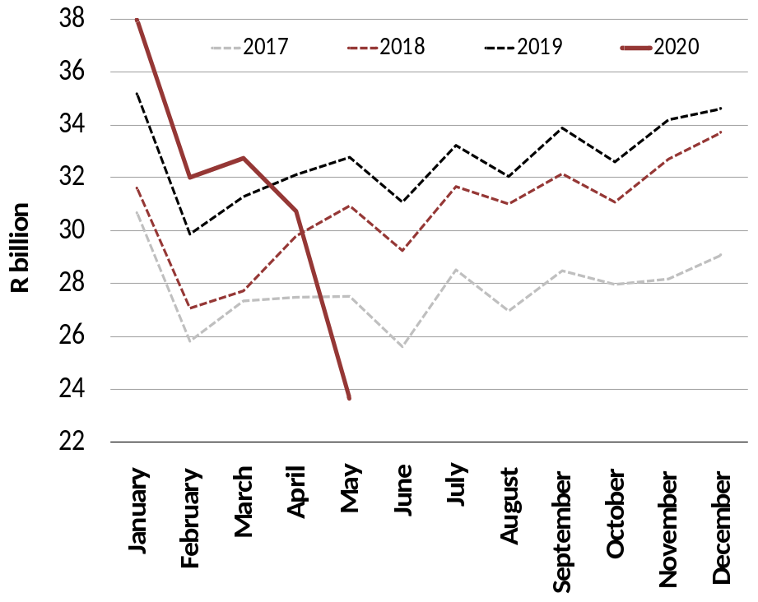
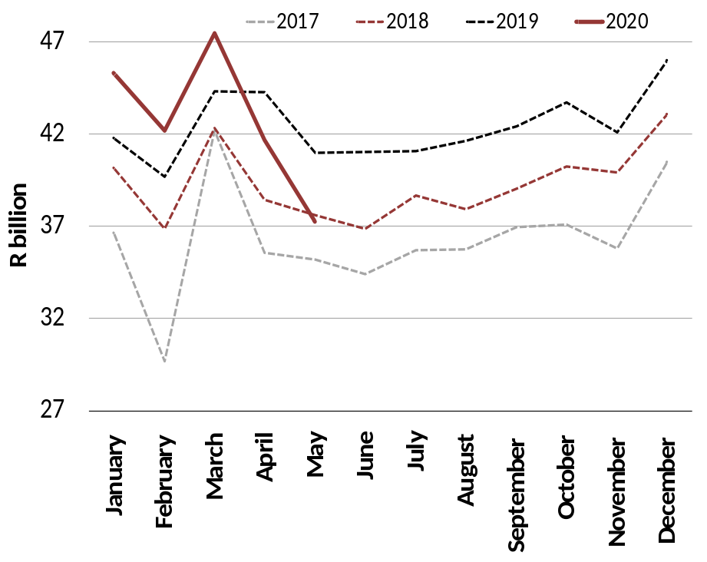
Year-to-date monthly revenue collections significantly weaker
Domestic value-added tax collections
Pay-as-you-earn collections

Slide 15
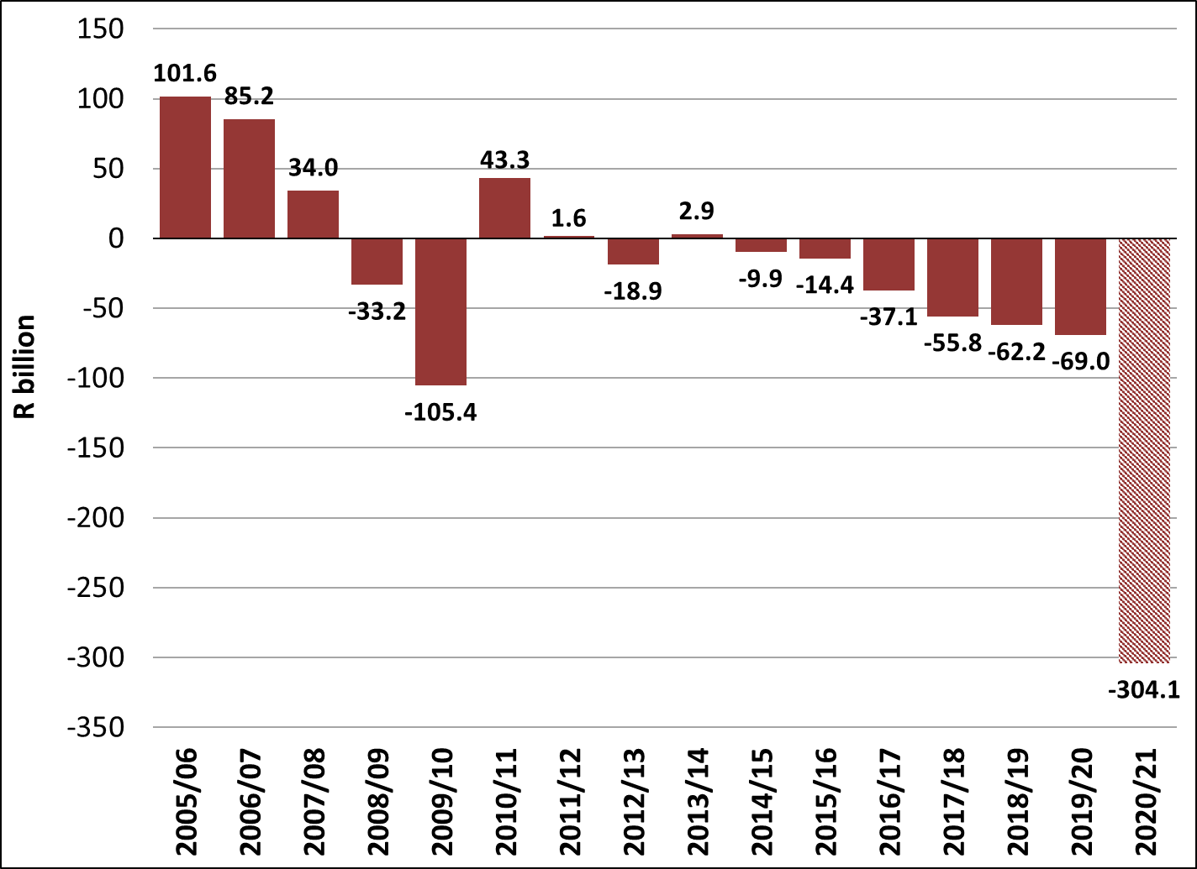
Tax revenue shortfall of R304.1 billion in 2020/21
In-year revenue compared with Budget forecasts (2020/21 prices)
COVID-19 fallout leads to unprecedented drop in in-year revenue estimates compared to prior Budget
Expect temporary shrinkage in tax base as businesses close and jobs are lost
Revenue shortfalls include tax relief measures amounting to R26 billion in foregone revenue
Improved tax collection and administration will be key to achieving fiscal stabilisation

Slide 16
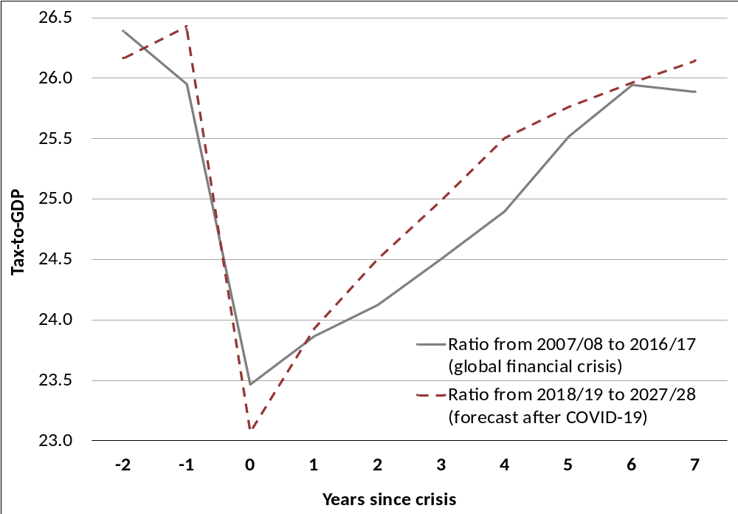
tax-to-gdp expected to be worse than global financial crisis
Tax-to-GDP after crisis
Tax-to-GDP expected to be worse than global financial crisis; but should recover along with economy and further tax measures

Slide 17
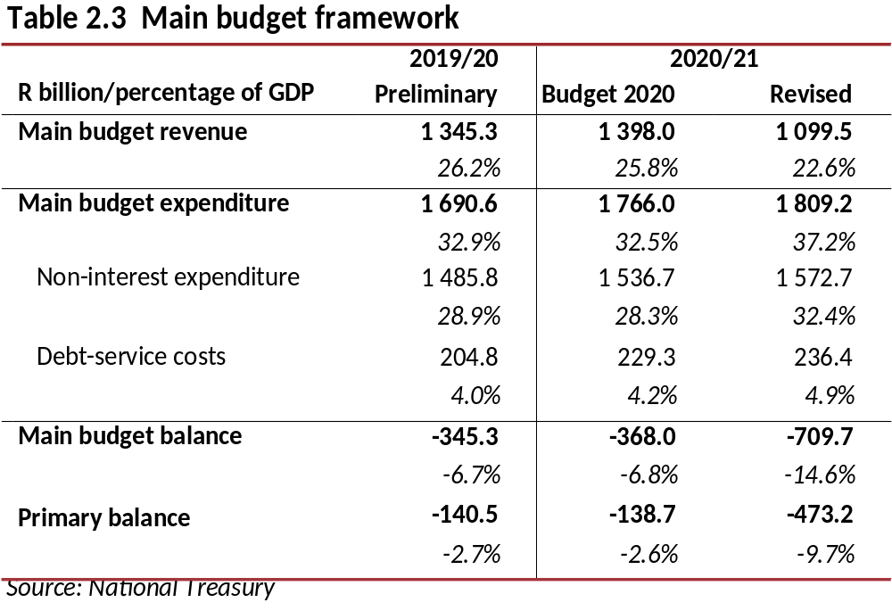
Updated fiscal framework for 2020/21
Main budget revenue is projected to decline as a share of GDP from 26.2 per cent in 2019/20 to 22.6 per cent in 2020/21
Main budget expenditure is projected to increase to 37.2 per cent of GDP in 2020/21, reflecting support provided to state-owned companies in the 2020 Budget, COVID-19 spending and higher debt-service costs.

Slide 18
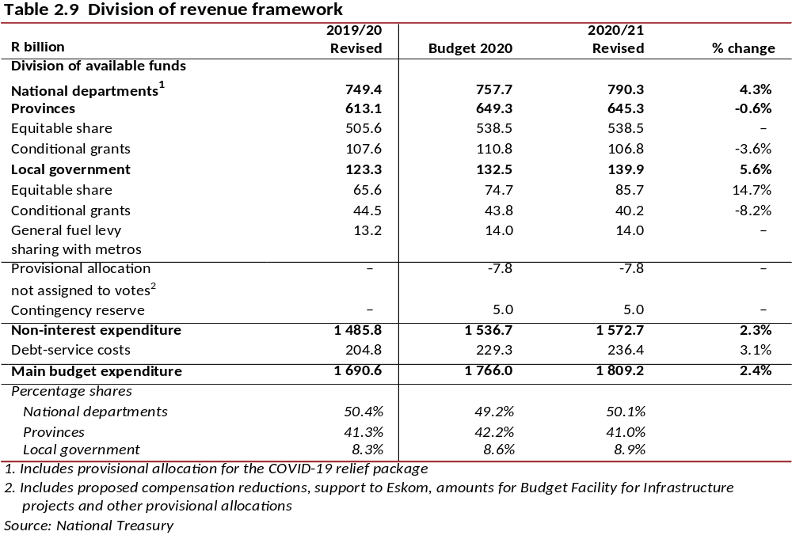
Changes to the division of revenue

Slide 19
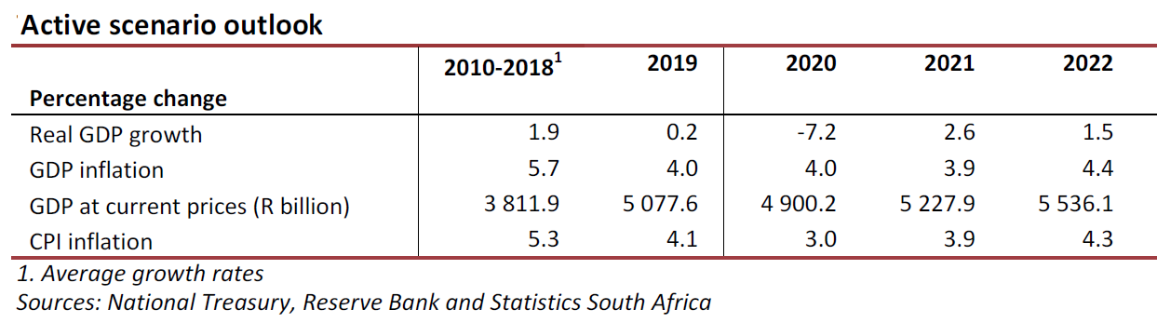
AN ACTIVE, INTEGRATED APPROACH TO the ECONOMY AND FISCUS NEEDED
Need active set of fiscal and economic reforms to raise confidence and growth
  Fiscal restraint mitigates borrowing cost increases, raises confidence
  SOC reform allows network industry reform, raises competition and lowers cost of living and doing business
  Economic reforms need to support investment and employment, raise productivity and competitiveness, and lower cost of living and doing business
Economic reforms take time to impact on growth outlook – hence the need to implement now
  Government envisages reforms to finalise electricity determinations, unbundling Eskom and other steps to open up energy markets, modernise ports and rail infrastructure, and license spectrum
  Reforms captured in Economic Transformation, Inclusive Growth, and Competitiveness: Towards an Economic Strategy for South Africa also included supporting labour intensive sectors, regional trade, SME finance
Additional reforms to support increased savings, investment and employment will be required to help speed the recovery from the COVID-19 shock

Slide 20
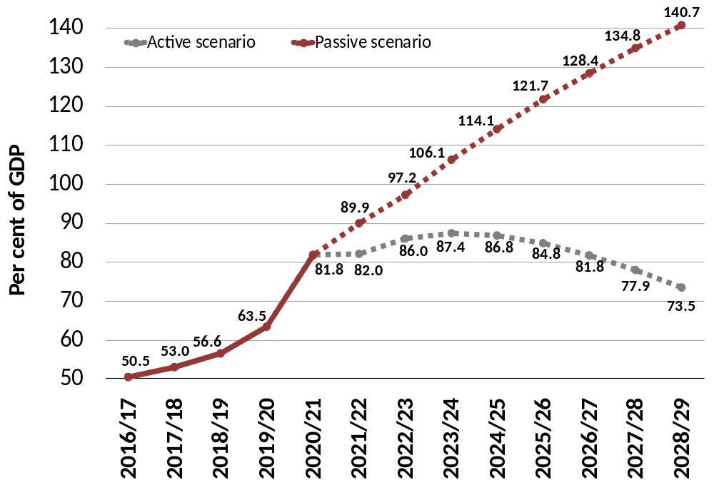
DEBT OUTLOOK SCENARIOS
In the active scenario, debt stabilises at 87.4 per cent of GDP in 2023/24

Slide 21
Medium-term fiscal position
Beyond 2020/21, government has considered two scenarios:
  A passive approach, in which South Africa continues on its current trajectory and debt spirals out of control; and
  An active scenario, in which major reforms and fiscal consolidation are implemented rapidly to stabilise debt in 2023/24.
Cabinet has adopted the active approach. It has endorsed the target of a primary surplus by 2023/24, meaning revenue will exceed non-interest expenditure.
This will require spending reductions and revenue adjustments amounting to approximately R250 billion over the next two years. Specifically, the active scenario assumes:
  Tax increases of R5 billion in 2021/22, R10 billion in 2022/23, R10 billion in 2023/24 and R15 billion in 2024/25.
  Spending reductions amounting to about R230 billion are required in 2021/22 and 2022/23, followed by further reductions in 2023/24.
These measures require difficult choices that will affect the economy and distribution of public resources. The 2020 MTBPS will set out these proposals in detail.
These measures are in addition to proposed medium-term reductions of R160.2 billion to the public-service wage bill set out in the 2020 Budget, which are yet to be finalised.
To promote fiscal consolidation, preparation of the 2021 MTEF will be informed by the results of forthcoming public expenditure reviews. Government’s consultations on the MTEF will also be guided by the principles of zero-based budgeting.

Slide 22
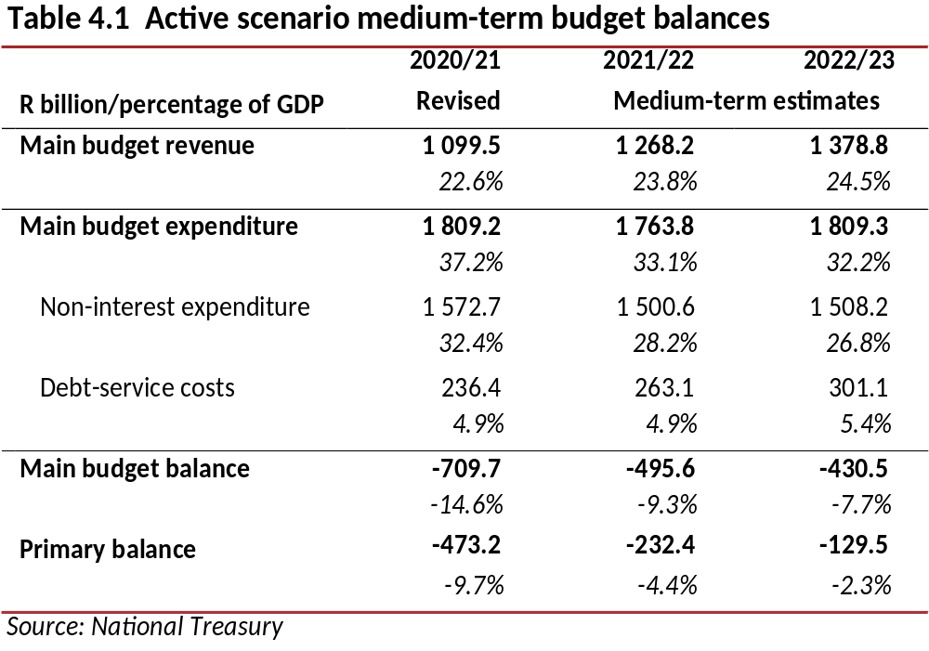
Active scenario fiscal position
The main budget balance and the primary balance will narrow over the medium term in order to stabilise debt in 2023/24

Slide 23
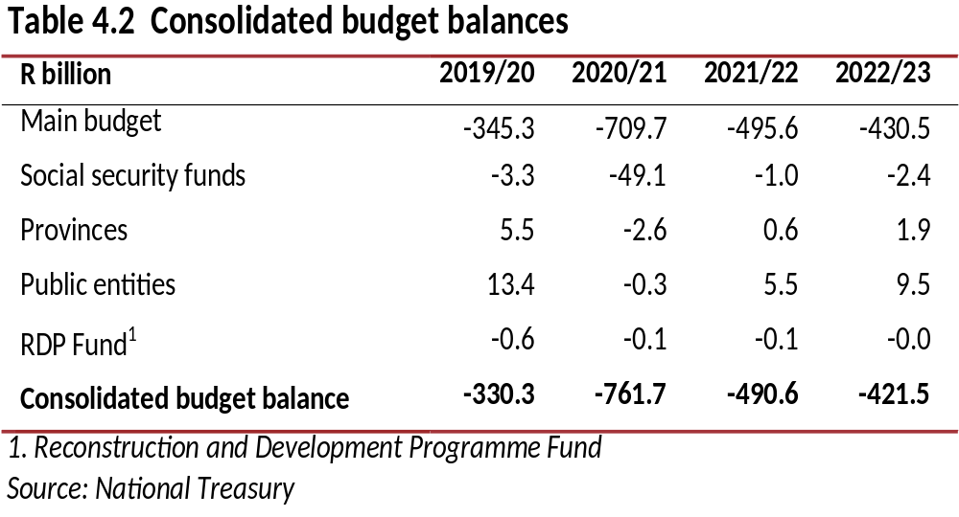
Consolidated budget balances
In 2020/21 the consolidated budget deficit will be revised from 6.8 per cent of GDP projected in the 2020 Budget to 15.7 per cent of GDP
Public entities, social security funds and provinces are projected to have a combined cash surplus in both 2021/22 and 2022/23.

Slide 24
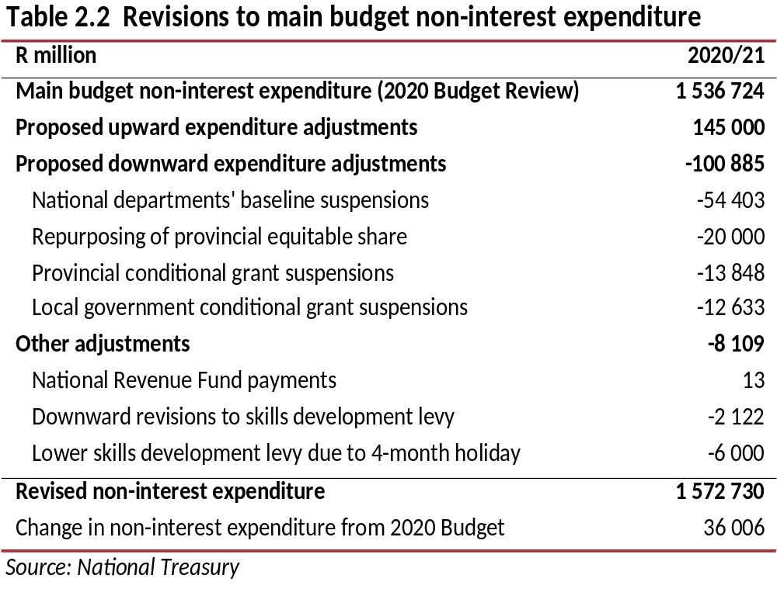
In-year spending adjustments
Main budget non-interest spending has increased by a net R36 billion in the current year.
This amount consists of R145 billion added to spending for the fiscal response to the pandemic. This amount is partially offset by R109 billion from the items shown in Table 2.2.

Slide 25
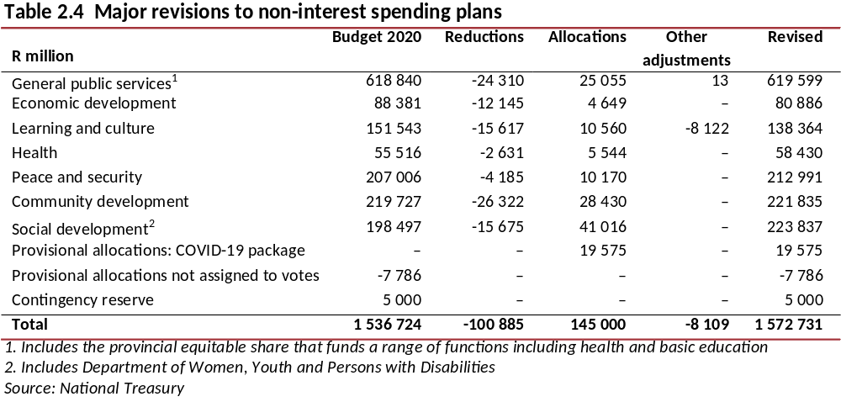
Revisions to main budget spending plans for 2020/21
Spending was adjusted by removing funds underspent due to delays caused by the lockdown from the baselines of affected departments; suspending allocations for capital and other departmental projects that could be delayed or rescheduled to 2021/22 or later; suspending allocations to programmes with a history of poor performance and/or slow spending and redirecting funds towards the COVID-19 response within functions, or towards government’s fiscal relief package.

Slide 26
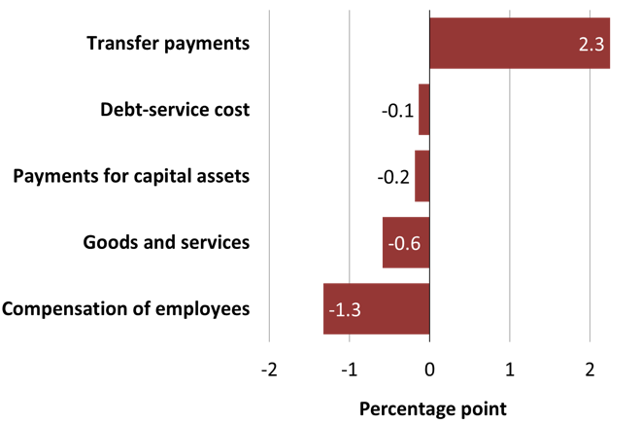
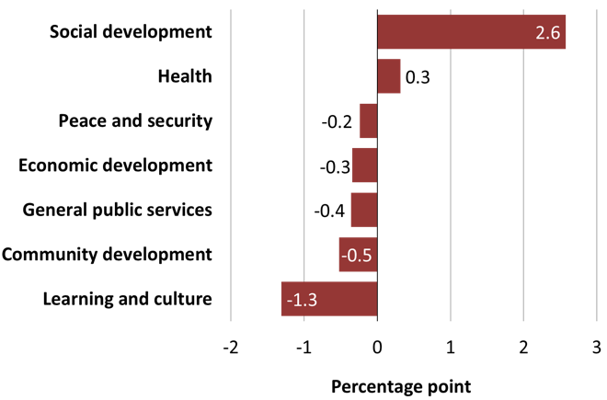
Consolidated budget spending and deficit for 2020/21
Change in share of expenditure by economic classification, 2020/21*
Change in share of expenditure by
function, 2020/21*
In the current year, R40 billion will be drawn down from social security funds’ cash surpluses to provide wage support to vulnerable employees due to the pandemic.
Consolidated spending for 2020/21 has been revised from R1.95 trillion in 2020 Budget to R2.04 trillion, mainly due to additional funding of R145 billion allocated for government’s COVID-19 response.
The consolidated budget deficit more than doubles to a projected 15.7 per cent of GDP in 2020/21

Slide 27
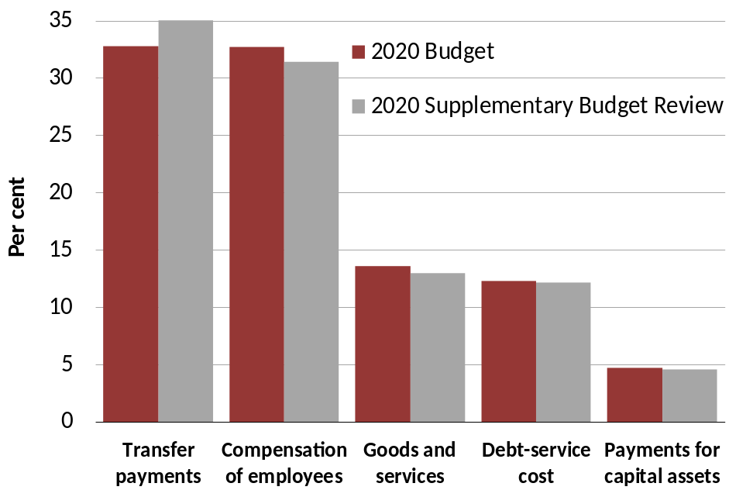
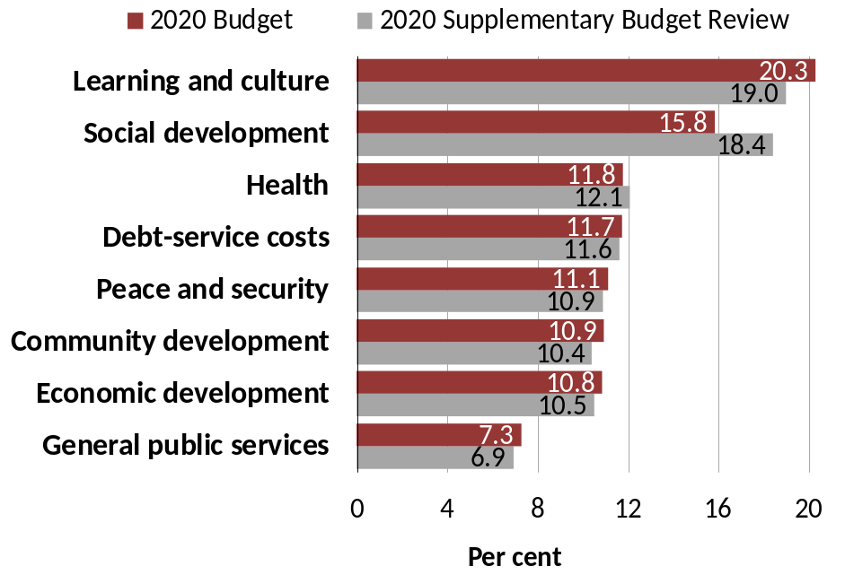
Consolidated budget spending plans for 2020/21
Share of consolidated expenditure by
economic classification, 2020/21
Share of consolidated expenditure by
function, 2020/21
The allocations increase spending on transfers to almost 35 per cent of total expenditure, while the share of all other components declines.
Debt-service costs are now the fourth-largest spending item, similar in size to what government spends on health services.

Slide 28
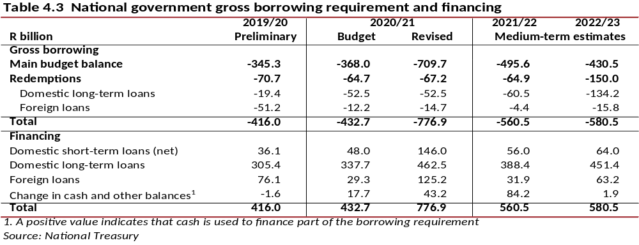
Financing the gross borrowing requirement
Since February 2020, the gross borrowing requirement for 2020/21 has increased by R344.2 billion to R776.9 billion. Government has revised its financing strategy to minimise the effect of this deteriorating financial position on its stock of debt and on debt-service costs.
The domestic capital market is under pressure. To moderate its domestic borrowing, government will draw down sterilisation deposits. It will also source funding from international finance institutions
Existing foreign cash deposits will be used to finance foreign currency commitments. The proceeds from international loans will be converted into rands to partially finance domestic commitments.

Slide 29
State-owned companies
The financial performance of state-owned companies, which has placed considerable pressure on the public finances for several years, is likely to deteriorate in 2020/21.
The pandemic and associated economic restrictions are expected to reduce revenues for entities such as the Airports Company South Africa, Eskom and the South African National Roads Agency Limited.
Global market volatility may further limit the ability of state-owned companies to borrow in capital markets and service their debt obligations.
The COVID-19 pandemic underlines the urgent need for broad-based reforms at state-owned companies so that they can become efficient and financially sustainable.
These reforms include rationalisation (reducing the number of and merging some state-owned companies, and incorporating certain functions into government), equity partnerships, and stronger policy certainty and implementation.
Planned transfers from the fiscus will be strictly conditional on improving their balance sheets.
The special adjustments budget includes an additional allocation of R3 billion to recapitalise the Land Bank in the current year
No other in-year spending adjustments are proposed for state-owned companies.

Slide 30
THANK YOU

